Slide 1
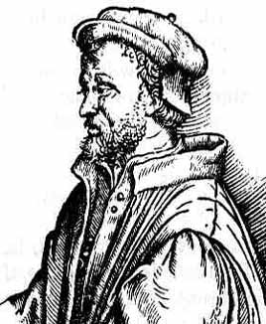

Math 250 Fresno State Fall 2013 Burger
Born: 1501 Died: 1576
Milan, Italy
Depressed Polynomial Equations,Cardano’s Formula and Solvability by Radicals (6.1)
(with a brief intro to Algebraic and Transcendental Numbers)

Slide 2
Outline
Countable and Uncountable Sets
Algebraic Numbers
Solvability by Radicals
Solving the Cubic (Cardano, et al.)
Existence of Transcendental Numbers
Examples of Transcendental Numbers
Constructible Numbers

Slide 3
Number Systems
N = natural numbers = {1, 2, 3, …}
Z = integers = {…, -2, -1, 0, 1, 2, …}
Q = rational numbers
R = real numbers
C = complex numbers

Slide 4
Countable Sets
A set is countable if there is a one-to-one correspondence between the set and N, the natural numbers

Slide 5
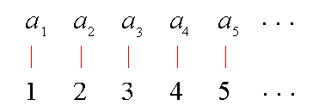
Countable Sets
A set is countable if there is a one-to-one correspondence between the set and N, the natural numbers

Slide 6
Countable Sets
N, Z, and Q are all countable

Slide 7
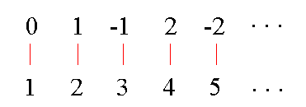
Countable Sets
N, Z, and Q are all countable

Slide 8
Uncountable Sets
R is uncountable

Slide 9
Uncountable Sets
R is uncountable
Therefore C is also uncountable

Slide 10
Uncountable Sets
R is uncountable
Therefore C is also uncountable
Uncountable sets are “bigger”

Slide 11
Algebraic Numbers
A complex number is algebraic if it is the solution to a polynomial equation
where the a_{i}’s are integers.

Slide 12
Algebraic Number Examples
51 is algebraic: x – 51 = 0
3/5 is algebraic: 5x – 3 = 0
Every rational number is algebraic:
Let a/b be any element of Q. Then a/b is a solution to bx – a = 0.

Slide 13
Algebraic Number Examples
is algebraic: x² – 2 = 0

Slide 14
Algebraic Number Examples
is algebraic: x² – 2 = 0
is algebraic: x³ – 5 = 0
is algebraic: x² – x – 1 = 0

Slide 15
Algebraic Number Examples
is algebraic: x² + 1 = 0

Slide 16
Algebraic Numbers
Any number built up from the integers with a finite number of additions, subtractions, multiplications, divisions, and n^{th} roots is an algebraic number

Slide 17
Algebraic Numbers
Any number built up from the integers with a finite number of additions, subtractions, multiplications, divisions, and n^{th} roots is an algebraic number
But not all algebraic numbers can be built this way, because not every polynomial equation is solvable by radicals

Slide 18
Solvability by Radicals
A polynomial equation is solvable by radicals if its roots can be obtained by applying a finite number of additions, subtractions, multiplications, divisions, and n^{th} roots to the integers

Slide 19
Solvability by Radicals
Every Degree 1 polynomial is solvable:

Slide 20
Solvability by Radicals
Every Degree 2 polynomial is solvable:
(Known by ancient Egyptians/Babylonians)

Slide 21
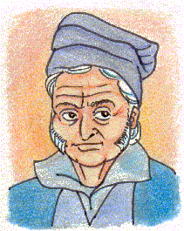
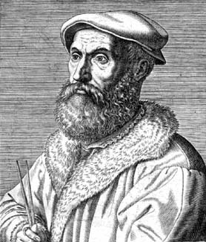
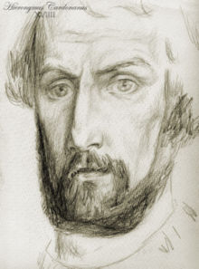
Solvability by Radicals
Every Degree 3 and Degree 4 polynomial is solvable
del Ferro Tartaglia Cardano Ferrari
(Italy, 1500’s)

Slide 22
Solvability by Radicals
Every Degree 3 and Degree 4 polynomial is solvable
We will be looking at the derivation of the Cubic Formula

Slide 23

Today’s Objectives
We will find a radical tower ‘over $ℚ ′$for which the last field contains the roots of the equation:
$y=$x³ + 6x² + 3x $−$10

Slide 24
The story of Cardano comes in the time of the renaissance. Due to the innovation of the printing press ideas are being shared all over europe. This also includes mathematical ideas. One of the most significant results of Cardano's work is the solution to the general cubic equation [2 p 133]. This is an equation of the form:
ax³ + bx² + cx + d = 0
which Cardano was able to find solutions for by extracting certain roots [3].
Before we begin with the story of Cardano, we must explain some history associated with the solution of the cubic. Although the solving of equation goes back to the very roots (no pun) of mathematics this segment of the story begins with Luca Pacioli (1445-1509). Paciloi authored a work Summ de Arithmetica, in which he summarized the solving of both linear and quadratic equations. This was a significant work because the algebra of the day was still in a very primitive form. The symbolism of today is not done at this time, but a written description of equations is used. Pacioli ponders the cubic and decides the problem is too difficult for the mathematics of the day [2 p 134].
Scipione del Ferro (1465-1526) continues the work that Pacioli had begun, but is more optimistic. Del Ferro is able to solve the "depressed cubic", that is a cubic equation that has no square term. The depressed cubic that del Ferro works with is of the form x³+mx=n where m and n are treated as known constants. The solution of the cubic equation is kept secret by del Ferro so that he has it to use in case his position is ever challenged. The solution of the cubic is told to Antonio Fior a student of del Ferro on del Ferro's death bed [2 pp 134-136].

Slide 25
Niccolo Fontana (1499-1557) better know as Tartaglia "The Stammer" (he got his nickname because he suffered a deep sword wound from a French soldier so that he could not speak very clearly) challenges Fior by each of them exchanging 30 problems. Fior is a very arrogant but not so talented mathematician. Fior gives Tartaglia 30 depressed cubics to solve. This is very "high stakes" at this time because Tartaglia will either get a 0 or a 30 depending if he can figure out the secret. Tartaglia a very gifted mathematician was able to find the solution to the depressed cubic after some struggle [2 pp 134-136].
This bit of history behind us, Cardano enters the picture of the cubic equation. Before we begin with the cubic we will make some biographical comments about Cardano.
Cardano was the illegitimate son of a very prominent father. His father was a consultant to Leonardo da Vinci. Cardano's illegitimacy had a huge impact throughout his life. His mother was given some poisons in order to attempt to induce an abortion, causing Cardano to suffer from a rash of physical ailments his entire life. Cardano would often inflict physical pain on himself because he said it would bring him relief when he stopped. He studied medicine at Padua, but was not able to practice in Milan because of his illegitimacy. Only later was he allowed to practice medicine after authoring a work on corrupt doctors that was popular among the people of Milan [2 pp 135-137].
Cardano's personal life was both strange and tragic. He was a mystic who believed in visions and dreams. He married because of a dream he had. His wife died at a very young age. He had two sons Giambattista and Aldo both of which Cardano had great hopes for since both were legitimate and would not have to face what Cardano did. Both sons ended up being a big disappointment, Giambattista killed his wife because of an affair which produced children and was put to death, Aldo was imprisoned as a criminal [2 pp 137-139] .

Slide 26
What’s a depressed polynomial equation?
An n^{th} degree polynomial equation is said to be depressed if it is missing the (n – 1)^{st} term. For example:
x² – 9 = 0
x³ + 8x = 9
x⁴ – 10x² + 4x + 8 = 0

Slide 27
A depressed quadratic equation is quite simple to solve.
And as you will see in later, there are techniques for solving depressed cubic and quartic equations.

Slide 28
Depressing an Equation
Substituting x = y – (b/na) in the equation
will result in a n^{th} degree, depressed equation in the variable y.
Once the depressed equation is solved, the substitution x = y – (b/na) can then be used to solve for x.

Slide 29
Here’s what the substitution x = y – (b/2a) does to a quadratic equation.

Slide 30
Since we substituted x = y – b/2a, the solution to the quadratic equation
ax² + bx + c = 0 is

Slide 31
Ex. 1: solve x³ + 6x² + 3x = 10
Making the substitution x = y – 6/3·1,
Thus this polynomial is ‘reducible in $ℚ$ and moreover has all of its roots in $ℚ;$thus we can not create a non-trivial tower of subfields.

Slide 32
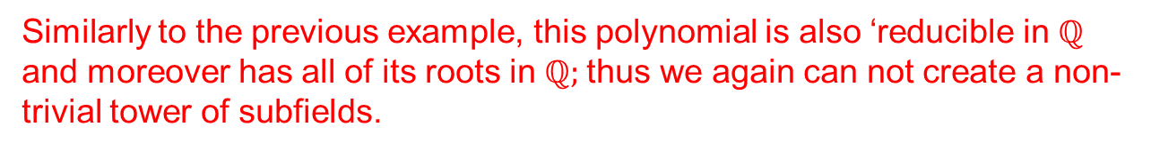
Ex.2: solve the quartic: x⁴ +12x³ + 49x² + 70x + 40 = 0
Making the substitution x = y – 12/4·1,
Similarly to the previous example, this polynomial is also ‘reducible in $ℚ$ and moreover has all of its roots in $ℚ;$thus we again can not create a non-trivial tower of subfields.

Slide 33
Not all cubic and quartic equations can be solved by solving the depressed equation as we did in the last two examples. It’s usually the case that the depressed equation can’t be solved using the techniques you learned in high school.
In the next example you will see how to solve any depressed ‘cubic’ equation.

Slide 34
-In the first example, you saw how to use the substitution x = y – b/3a to convert the cubic equation ax³ + bx² + cx + d = 0 into a depressed cubic equation:
y³ + my = n.
-And you also saw that in the special case where n = 0, so you could solve the depressed equation by simply factoring.
-Now you will see how to solve the depressed cubic y³ + my = n, independent of the values of m and n.

Slide 35
-What we will do is derive Cardano’s formula for finding one solution to the depressed cubic equation.
-When Cardano wrote his proof in the 16th century, he started by imagining a large cube having sides measuring t. Each side was divided into segments measuring t – u and u in such a way that cubes could be constructed in diagonally opposite corners of the cube.

Slide 36
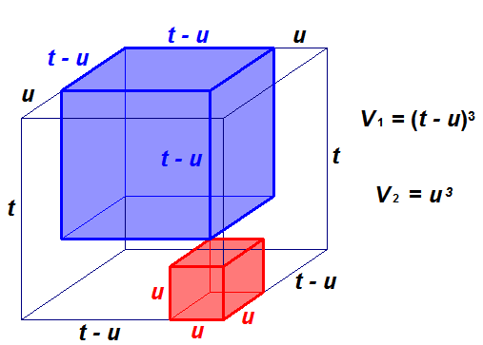
This divides the large cube into 6 parts, two of which are pictured here.

Slide 37
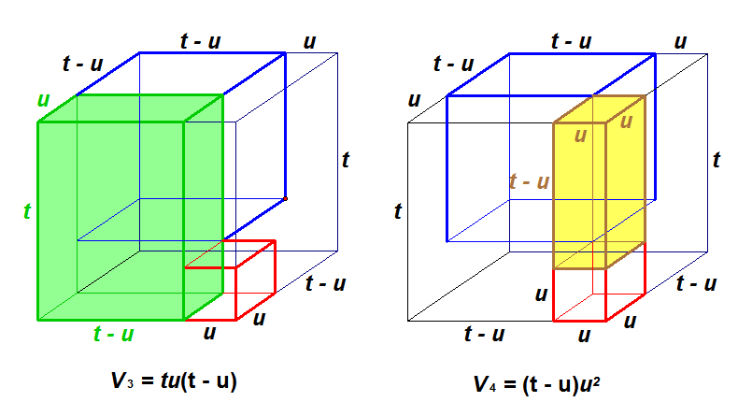

Slide 38
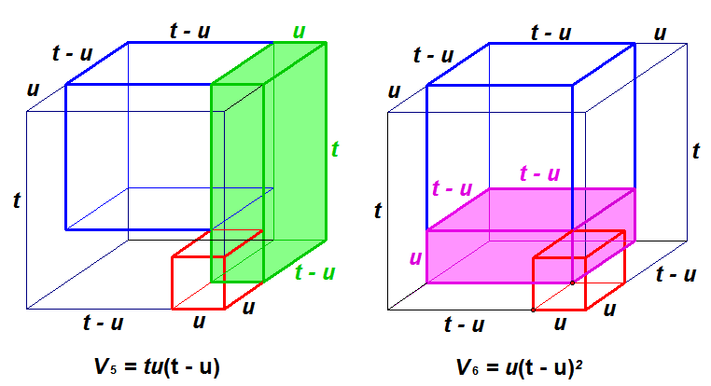

Slide 39
Since the volume t³ of the large cube is equal to the sum of the volumes of its six parts, we get:
which luckily can be expressed as:

Slide 40
This is reminiscent of the depressed cubic y³ + my = n we want to solve. So set
y = t – u, m = 3tu, and n = t³ – u³.
Substituting u = m/3t into n = t³ – u³,
gives which simplifies to

Slide 41
y = t – u, m = 3tu,
n = t³ – u³
But this is a quadratic in t³. So using only the positive square root we get,

Slide 42
y = t – u, m = 3tu,
n = t³ – u³
And since u³ = t³ – n, we get

Slide 43
y = t – u, m = 3tu,
n = t³ – u³
Since y = t – u, we now have Cardano’s formula for solving the depressed cubic.

Slide 44
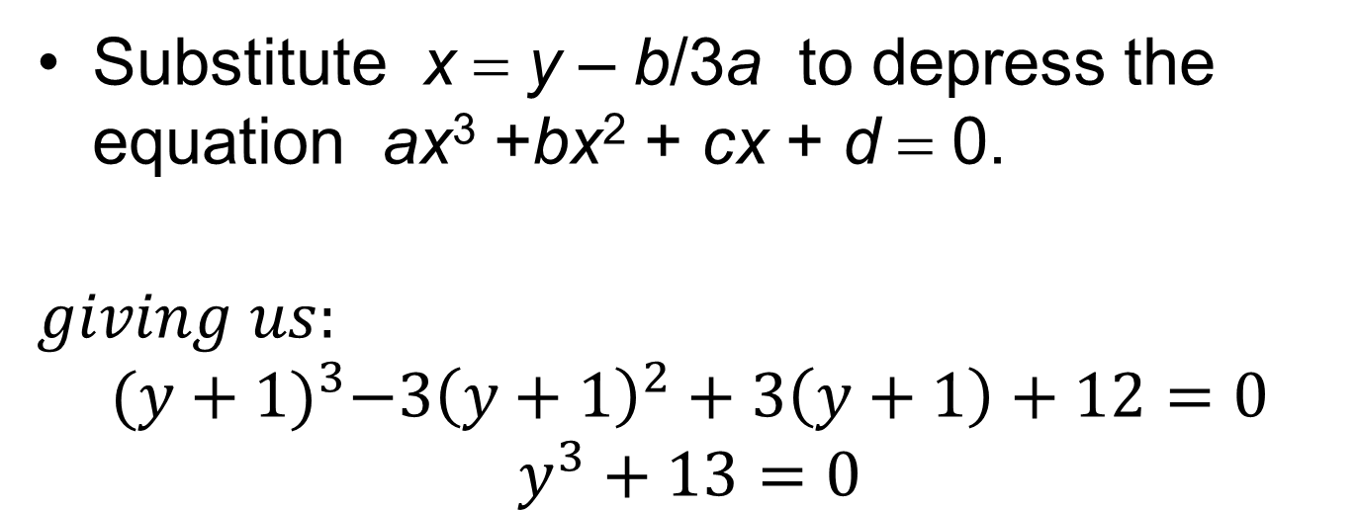
Ex. 3: Find all solutions to x³ – 3x² + 3x +12 = 0 (8(ii) of section 6.1 in Nicodemi text)
Substitute x = y – b/3a to depress the equation ax³ +bx² + cx + d = 0.
$$giving us:$$
$${(y+1)}^{3}−3{\left(y+1\right)}^{2}+3\left(y+1\right)+12=0$$
$$y^{3}+13=0$$

Slide 45
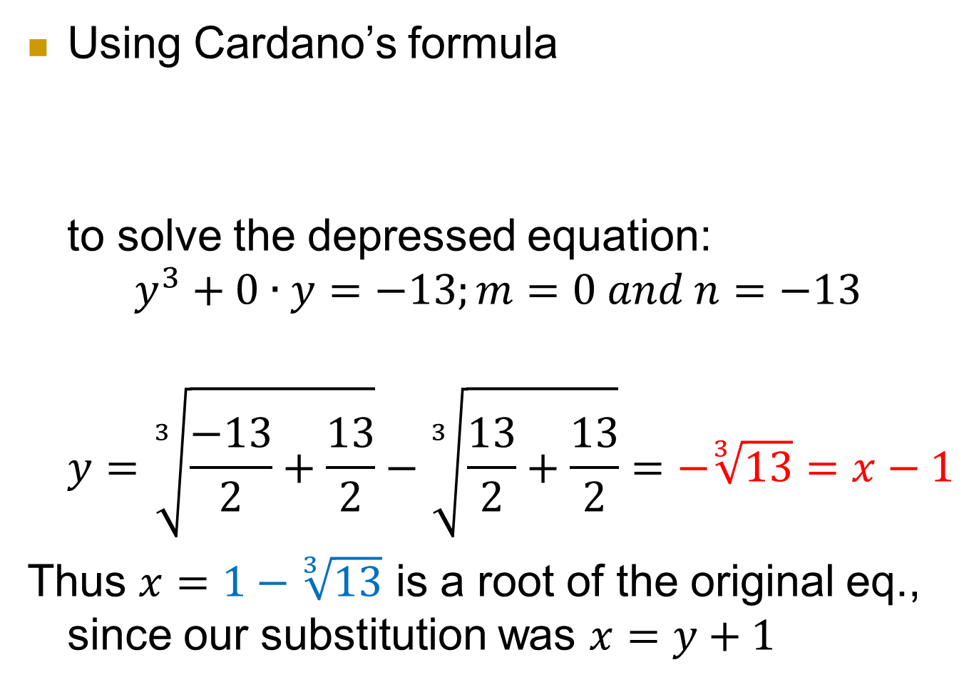
Using Cardano’s formula
to solve the depressed equation:
$$y^{3}+0∙y=−13;m=0 and n=−13$$
$$y=\sqrt[3]{\frac{−13}{2}+\frac{13}{2}}−\sqrt[3]{\frac{13}{2}+\frac{13}{2}}=−\sqrt[3]{13}=x−1$$
Thus $x=1−\sqrt[3]{13}$ is a root of the original eq., since our substitution was $x=y+1$

Slide 46
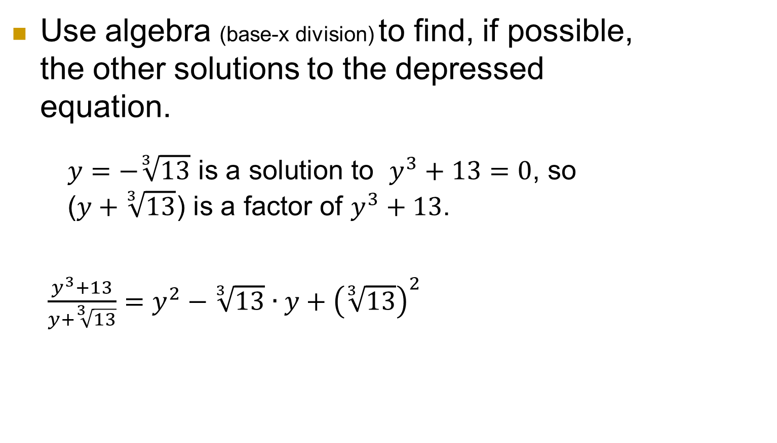
Use algebra (base-x division) to find, if possible, the other solutions to the depressed equation.
$y=−\sqrt[3]{13}$ is a solution to $y^{3}+13=0$, so ($y+\sqrt[3]{13}$) is a factor of $y^{3}+13$.
$\frac{y^{3}+13}{y+\sqrt[3]{13}}=y^{2}−\sqrt[3]{13}∙y+{\left(\sqrt[3]{13}\right)}^{2}$

Slide 47
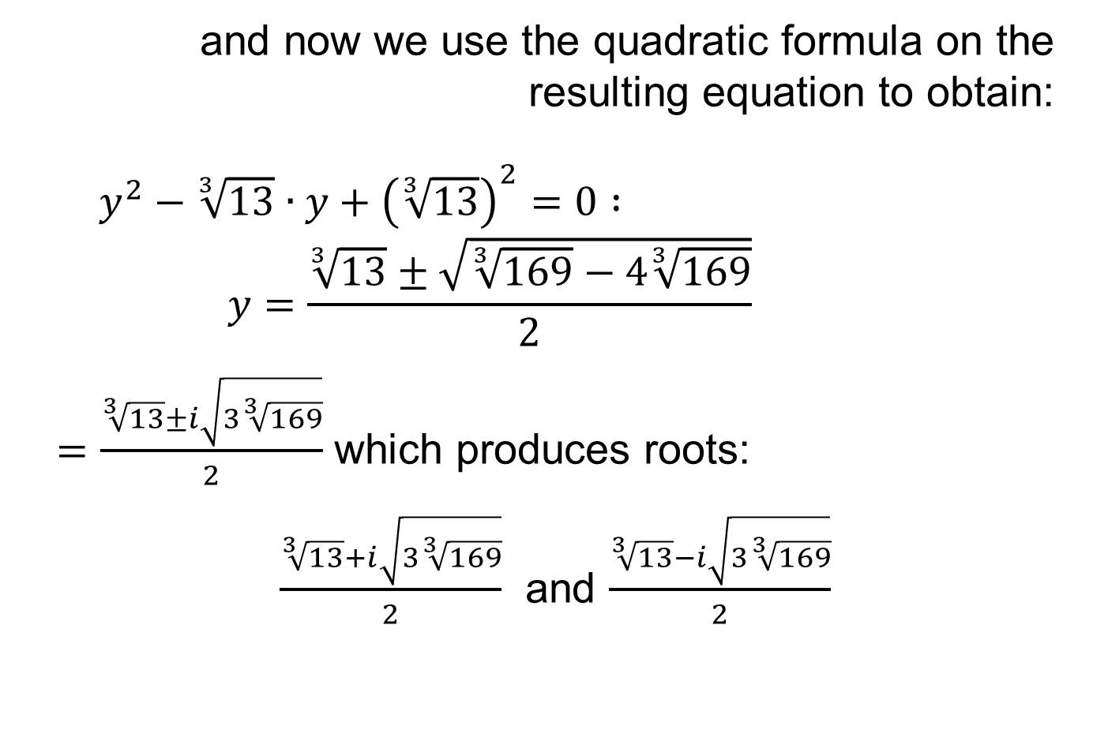
and now we use the quadratic formula on the resulting equation to obtain:
$y^{2}−\sqrt[3]{13}∙y+{\left(\sqrt[3]{13}\right)}^{2}=0 :$
$$y=\frac{\sqrt[3]{13}±\sqrt{\sqrt[3]{169}−4\sqrt[3]{169}}}{2}$$
$=\frac{\sqrt[3]{13}±i\sqrt{3\sqrt[3]{169}}}{2}$ which produces roots:
$\frac{\sqrt[3]{13}+i\sqrt{3\sqrt[3]{169}}}{2}$ and $\frac{\sqrt[3]{13}−i\sqrt{3\sqrt[3]{169}}}{2}$

Slide 48
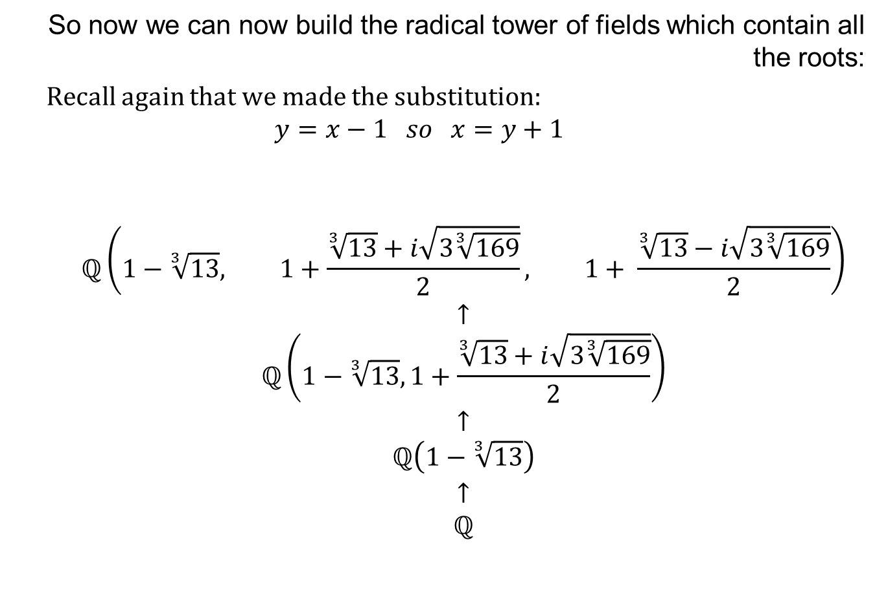
So now we can now build the radical tower of fields which contain all the roots:
Recall again that we made the substitution:
$$y=x−1 so x=y+1$$
$$\begin{matrix}ℚ\left(1−\sqrt[3]{13}, 1+\frac{\sqrt[3]{13}+i\sqrt{3\sqrt[3]{169}}}{2}, 1+ \frac{\sqrt[3]{13}−i\sqrt{3\sqrt[3]{169}}}{2}\right) \\ ↑ \\ \begin{matrix}ℚ\left(1−\sqrt[3]{13},1+\frac{\sqrt[3]{13}+i\sqrt{3\sqrt[3]{169}}}{2}\right) \\ ↑ \\ \begin{matrix}ℚ\left(1−\sqrt[3]{13}\right) \\ \begin{matrix}↑ \\ ℚ\end{matrix}\end{matrix}\end{matrix}\end{matrix}$$

Slide 49
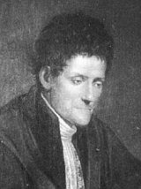
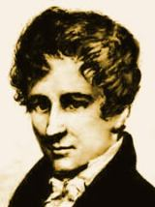
Solvability by Radicals
For every Degree 5 or higher, there are polynomials that are not solvable
Ruffini (Italian) Abel (Norwegian)
(1800’s)

Slide 50
Solvability by Radicals
For every Degree 5 or higher, there are polynomials that are not solvable
is not solvable by radicals

Slide 51
Solvability by Radicals
For every Degree 5 or higher, there are polynomials that are not solvable
is not solvable by radicals
The roots of this equation are algebraic

Slide 52
Solvability by Radicals
For every Degree 5 or higher, there are polynomials that are not solvable
is solvable by radicals

Slide 53
Algebraic Numbers
The algebraic numbers form a field, denoted by A

Slide 54
Algebraic Numbers
The algebraic numbers form a field, denoted by A
In fact, A is the algebraic closure of Q

Slide 55
Question
Are there any complex numbers that are not algebraic?

Slide 56
Question
Are there any complex numbers that are not algebraic?
A complex number is transcendental if it is not algebraic

Slide 57
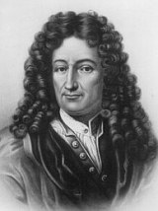
Question
Are there any complex numbers that are not algebraic?
A complex number is transcendental if it is not algebraic
Terminology from Leibniz

Slide 58
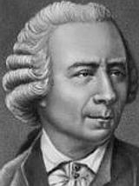
Question
Are there any complex numbers that are not algebraic?
A complex number is transcendental if it is not algebraic
Terminology from Leibniz
Euler was one of the first to
conjecture the existence of
transcendental numbers

Slide 59
Existence of Transcendental Numbers
In 1844, the French mathematician Liouville proved that some complex numbers are transcendental

Slide 60
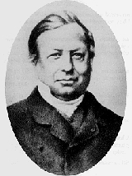
Existence of Transcendental Numbers
In 1844, the French mathematician Liouville proved that some complex numbers are transcendental

Slide 61
Existence of Transcendental Numbers
His proof was not constructive, but in 1851, Liouville became the first to find an example of a transcendental number

Slide 62
Existence of Transcendental Numbers
His proof was not constructive, but in 1851, Liouville became the first to find an example of a transcendental number

Slide 63
Existence of Transcendental Numbers
Although only a few “special” examples were known in 1874, Cantor proved that there are infinitely-many more transcendental numbers than algebraic numbers

Slide 64
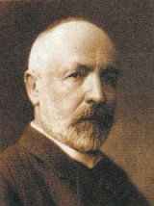
Existence of Transcendental Numbers
Although only a few “special” examples were known in 1874, Cantor proved that there are infinitely-many more transcendental numbers than algebraic numbers

Slide 65
Existence of Transcendental Numbers
Theorem (Cantor, 1874): A, the set of algebraic numbers, is countable.

Slide 66
Existence of Transcendental Numbers
Theorem (Cantor, 1874): A, the set of algebraic numbers, is countable.
Corollary: The set of transcendental numbers must be uncountable. Thus there are infinitely-many more transcendental numbers.

Slide 67
Existence of Transcendental Numbers
Proof: Let a be an algebraic number, a solution of

Slide 68
Existence of Transcendental Numbers
Proof: Let a be an algebraic number, a solution of
We may choose n of the smallest possible degree and assume that the coefficients are relatively prime

Slide 69
Existence of Transcendental Numbers
Proof: Let a be an algebraic number, a solution of
We may choose n of the smallest possible degree and assume that the coefficients are relatively prime
Then the height of a is the sum

Slide 70
Existence of Transcendental Numbers
Claim: Let k be a positive integer. Then the number of algebraic numbers that have height k is finite.

Slide 71
Existence of Transcendental Numbers
Claim: Let k be a positive integer. Then the number of algebraic numbers that have height k is finite.
Let a have height k. Let n be the degree of the polynomial for a in the definition of a’s height.

Slide 72
Existence of Transcendental Numbers
Claim: Let k be a positive integer. Then the number of algebraic numbers that have height k is finite.
Let a have height k. Let n be the degree of the polynomial for a in the definition of a’s height.
Then n cannot be bigger than k, by definition.

Slide 73
Existence of Transcendental Numbers
Claim: Let k be a positive integer. Then the number of algebraic numbers that have height k is finite.
Also,
implies that there are only finitely-many choices for the coefficients of the polynomial.

Slide 74
Existence of Transcendental Numbers
Claim: Let k be a positive integer. Then the number of algebraic numbers that have height k is finite.
So there are only finitely-many choices for the coefficients of each polynomial of degree n leading to a height of k.

Slide 75
Existence of Transcendental Numbers
Claim: Let k be a positive integer. Then the number of algebraic numbers that have height k is finite.
So there are only finitely-many choices for the coefficients of each polynomial of degree n leading to a height of k.
Thus there are finitely-many polynomials of degree n that lead to a height of k.

Slide 76
Existence of Transcendental Numbers
Claim: Let k be a positive integer. Then the number of algebraic numbers that have height k is finite.
This is true for every n less than or equal to k, so there are finitely-many polynomials that have roots with height k.

Slide 77
Existence of Transcendental Numbers
Claim: Let k be a positive integer. Then the number of algebraic numbers that have height k is finite.
This means there are finitely-many such roots to these polynomials, i.e., there are finitely-many algebraic numbers of height k.

Slide 78
Existence of Transcendental Numbers
Claim: Let k be a positive integer. Then the number of algebraic numbers that have height k is finite.
This means there are finitely-many such roots to these polynomials, i.e., there are finitely-many algebraic numbers of height k.
This proves the claim.

Slide 79
Existence of Transcendental Numbers
Back to the theorem: We want to show that A is countable.

Slide 80
Existence of Transcendental Numbers
Back to the theorem: We want to show that A is countable.
For each height, put the algebraic numbers of that height in some order

Slide 81
Existence of Transcendental Numbers
Back to the theorem: We want to show that A is countable.
For each height, put the algebraic numbers of that height in some order
Then put these lists together, starting with height 1, then height 2, etc., to put all of the algebraic numbers in order

Slide 82
Existence of Transcendental Numbers
Back to the theorem: We want to show that A is countable.
For each height, put the algebraic numbers of that height in some order
Then put these lists together, starting with height 1, then height 2, etc., to put all of the algebraic numbers in order
The fact that this is possible proves that A is countable.

Slide 83
Existence of Transcendental Numbers
Since A is countable but C is uncountable, there are infinitely-many more transcendental numbers than there are algebraic numbers

Slide 84
Existence of Transcendental Numbers
Since A is countable but C is uncountable, there are infinitely-many more transcendental numbers than there are algebraic numbers
“The algebraic numbers are spotted over the plane like stars against a black sky; the dense blackness is the firmament of the transcendentals.”
E.T. Bell, math historian

Slide 85
Examples of Transcendental Numbers
In 1873, the French mathematician Charles Hermite proved that e is transcendental.

Slide 86
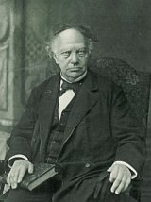
Examples of Transcendental Numbers
In 1873, the French mathematician Charles Hermite proved that e is transcendental.

Slide 87
Examples of Transcendental Numbers
In 1873, the French mathematician Charles Hermite proved that e is transcendental.
This is the first number proved to be transcendental that was not constructed for such a purpose

Slide 88
Examples of Transcendental Numbers
In 1882, the German mathematician Ferdinand von Lindemann proved that
is transcendental

Slide 89
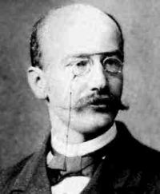
Examples of Transcendental Numbers
In 1882, the German mathematician Ferdinand von Lindemann proved that
is transcendental

Slide 90
Examples of Transcendental Numbers
Still very few known examples of transcendental numbers:

Slide 91
Examples of Transcendental Numbers
Still very few known examples of transcendental numbers:

Slide 92
Examples of Transcendental Numbers
Open questions:

Slide 93
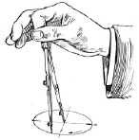
Constructible Numbers
Using an unmarked straightedge and a collapsible compass, given a segment of length 1, what other lengths can we construct?

Slide 94
Constructible Numbers
For example, is constructible:

Slide 95
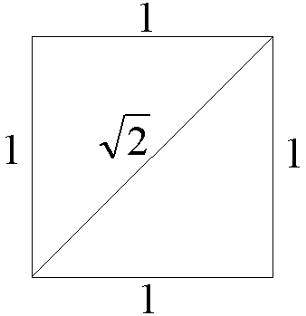
Constructible Numbers
For example, is constructible:

Slide 96
Constructible Numbers
The constructible numbers are the real numbers that can be built up from the integers with a finite number of additions, subtractions, multiplications, divisions, and the taking of square roots

Slide 97
Constructible Numbers
Thus the set of constructible numbers, denoted by K, is a subset of A.

Slide 98
Constructible Numbers
Thus the set of constructible numbers, denoted by K, is a subset of A.
K is also a field

Slide 99
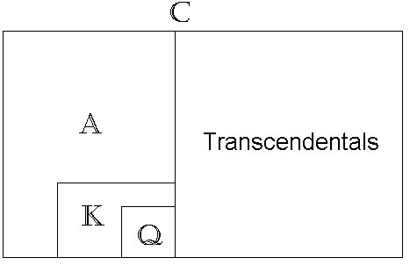
Constructible Numbers

Slide 100
Constructible Numbers
Most real numbers are not constructible

Slide 101
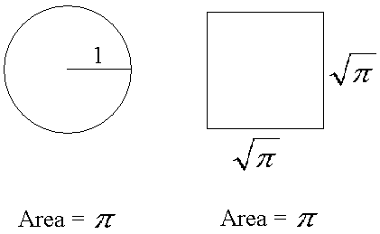
Constructible Numbers
In particular, the ancient question of squaring the circle is impossible … more on this later!

